Slide 1
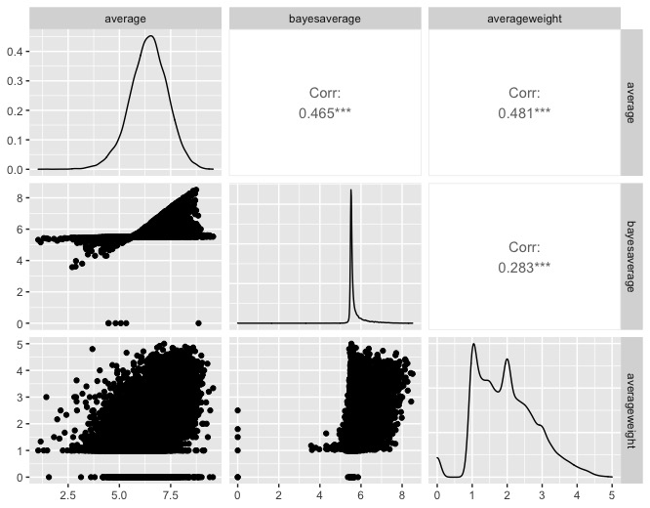
Nonparametric statistics project - Board Games Reviews
We selected in this slide some of the most interesting columns:
The ‘average’ represents the average of the ratings given by the users.
The ‘averageweight’ is an index that quantifies the complexity of the game
The ‘category’ information will be treated through the usage of dummy variables
Other relevant columns can be: minplayers, maxplayers, mechanic,…
NAME | YEAR | PLAYING TIME | NUM RATINGS | AVERAGE | BAYES AVERAGE | AVERAGE WEIGHT | CATEGORY
DIE MACHER | 1986 | 240 | 5366 | 7.6148 | 7.10045 | 4.3206 | Economic, Negotiation, Political
DRAGON MASTER | 1981 | 30 | 561 | 6.64206 | 5.78172 | 1.9630 | Card Game, Fantasy
SAMURAI | 1998 | 60 | 15202 | 7.45491 | 7.23898 | 2.4866 | Abstract Strategy, Medieval
ACQUIRE | 1964 | 90 | 18721 | 7.33797 | 7.14131 | 2.5019 | Economic, Territory Building

Slide 2
Why Board Games?
Board games are becoming more and more popular nowadays. Their popularity started growing during covid-19 outbreak, and people now can’t stop playing them!
Board games companies should be able to understand what characterises a succesful board game in order to match the requests from the customers.
Our Goals
explain and predict rating of a board game based on its characteristics.
Understand possible trends: which games are more popular? Which characteristics make a game more appealing nowadays? Which categories are more appreciated?

Slide 3

Nonparametric tools that can be deployed in our analysis:
Depth measures to detect outliers
Nonparametric inference with response variable the average rating and using as features the ones showed before
Permutational tests between categories to detect differences in average rating
Conformal prediction of average rating

